Slide 1
Multimedia Systems Lecture – 27
By
Dr. Priyambada Subudhi
Assistant Professor
IIIT Sri City

Slide 2
Dictionary-Based Coding
Dictionary-based coding techniques replace input strings with a code to an entry in a dictionary.
The most well known dictionary-based techniques are Lempel-Ziv Algorithms and their variants.
The Lempel-Ziv-Welch (LZW) algorithm employs an adaptive, dictionary-based compression technique.
Unlike variable-length coding, in which the lengths of the codewords are different, LZW uses fixed-length codewords to represent variablelength strings of symbols/characters that commonly occur together, such as words in English text.

Slide 3
As in the other adaptive compression techniques, the LZW encoder and decoder builds up the same dictionary dynamically while receiving the data—the encoder and the decoder both develop the same dictionary.
Since a single code can now represent more than one symbol /character, data compression is realized.
LZW proceeds by placing longer and longer repeated entries into a dictionary, then emitting the code for an element rather than the string itself, if the element has already been placed in the dictionary.
The predecessors of LZW are LZ77 and LZ78.
LZW is used in many applications, such as UNIX compress, GIF for images, WinZip, and others.

Slide 4
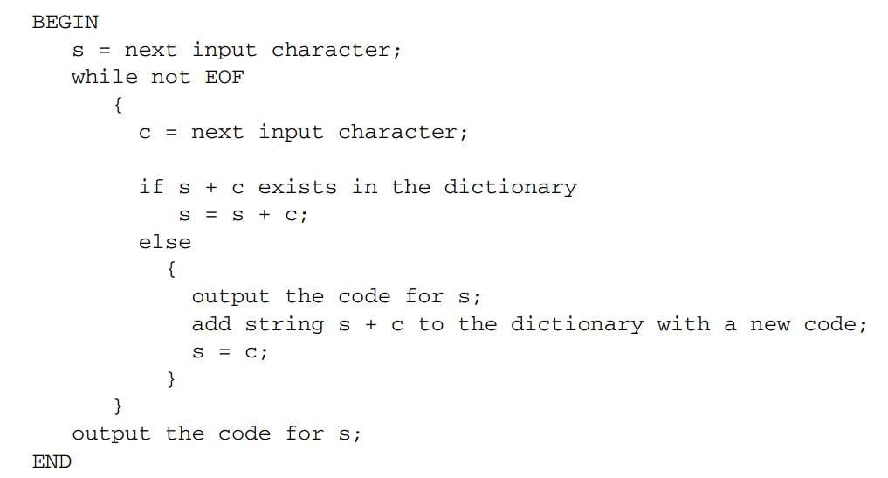




LZW Compression

Slide 5
Example (LZW Compression for String ABABBABCABABBA)
Let us start with a very simple dictionary (also referred to as a string table), initially containing only three characters, with codes as follows:
code string
1 A
2 B
3 C

Slide 6
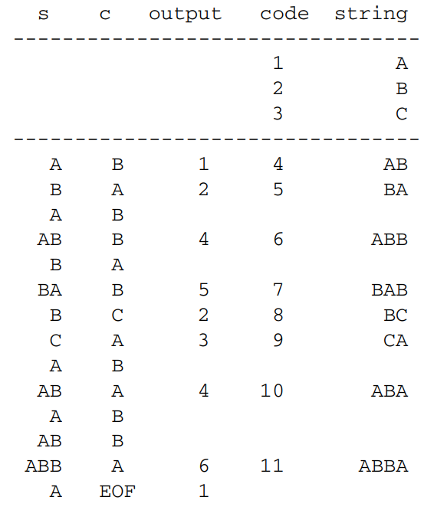




Now if the input string is ABABBABCABABBA, the LZW compression algorithm works as follows:

Slide 7
The output codes are 1 2 4 5 2 3 4 6 1. Instead of 14 characters, only 9 codes need to be sent.
If we assume each character or code is transmitted as a byte, that is quite a saving (the compression ratio would be 14/9 = 1.56).
LZW is an adaptive algorithm, in which the encoder and decoder independently build their own string tables. Hence, there is no overhead involving transmitting the string table.
The above example is replete with a great deal of redundancy in the input string, which is why it achieves compression so quickly.
In general, savings for LZW would not come until the text is more than a few hundred bytes long.

Slide 8
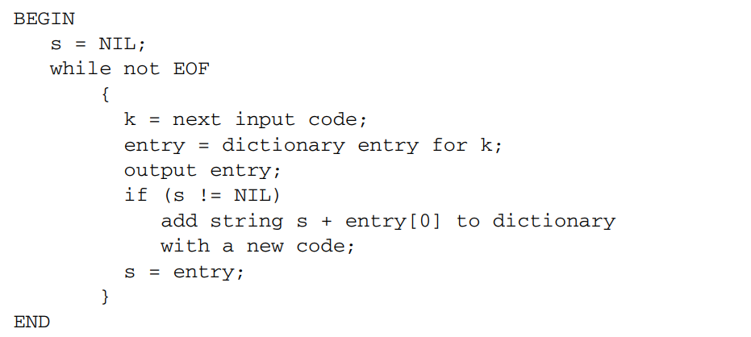
LZW Decompression

Slide 9
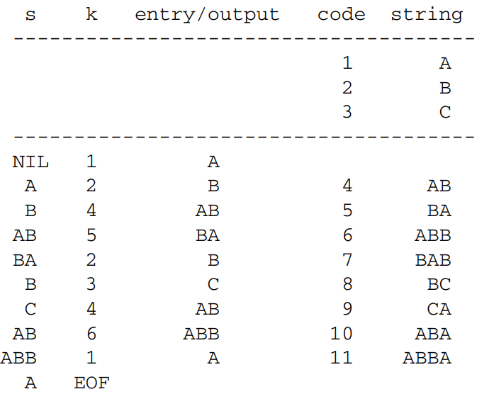




Example (LZW decompression for string ABABBABCABABBA).
Input codes to the decoder are 1 2 4 5 2 3 4 6 1. The initial string table is identical to what is used by the encoder. The LZW decompression algorithm then works as follows:

Slide 10
A more careful examination of the above simple version of the LZW decompression algorithm will reveal a potential problem.
In adaptively updating the dictionaries, the encoder is sometimes ahead of the decoder.
For example, after the sequence ABABB, the encoder will output code 4 and create a dictionary entry with code 6 for the new string ABB.
On the decoder side, after receiving the code 4, the output will be AB, and the dictionary is updated with code 5 for a new string, BA.
Welch points out that the simple version of the LZW decompression algorithm will break down when the following scenario occurs.

Slide 11
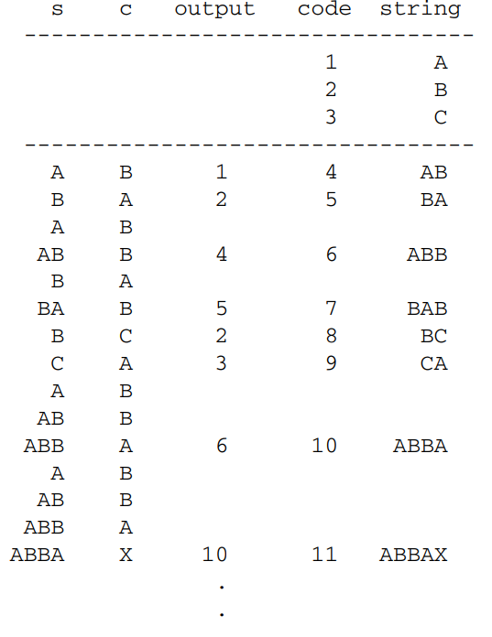
Assume that the input string is ABABBABCABBABBAX....
The LZW encoder:

Slide 12
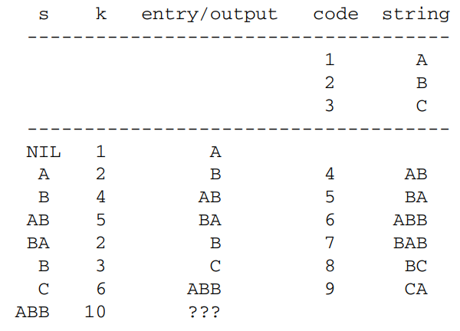
The sequence of output codes from the encoder (and hence the input codes for the decoder) is 1 2 4 5 2 3 6 10 ...
The simple LZW decoder:

Slide 13
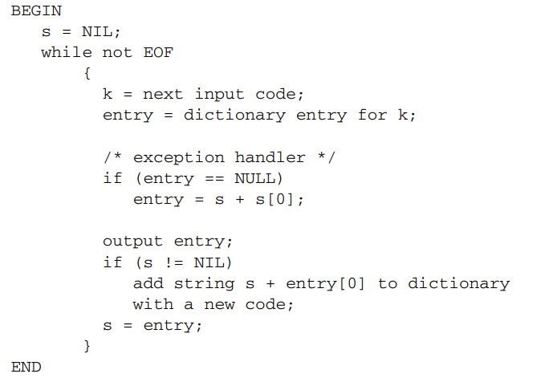
LZW Decompression (Modified)

